Slide 1
CS 547 - Deep Dive Project - Group 21 - Project 1 California Unemployment
psg4, sk120, sb70, maahidp23
Team members:
Pritham Sriram Govindaraj (psg4)
Saiharshith Karuneegar Ramesh (sk120)
Suraj Vashista Bettadapura Krishna (sb70)
Maahi Patel (maahidp23)

Slide 2
Outline
psg4, sk120
Background
Problem Statement
Data
Challenges
Solution
Results
Conclusion and Future Work

Slide 3
Background
sb70, maahidp23
California, being the tech powerhouse that it is, may be a top choice for recent UIUC grads.
Many people opt to leave everything behind in search of their dream career in Silicon Valley, captivated by the charm of the Golden State.
However, it's one thing to have a job lined up before making such a move, and quite another to have a few backup jobs in mind in case there are any problems with the present work.

Slide 4
Problem Statement
psg4, maahidp23
With a population of almost 40 million, the state of California's politicians are continuously battling high inflation and poverty rates, which are in many ways linked to employment—or the lack thereof.
Having stated that, is it feasible to forecast California's employment rate for the remainder of the decade?
A forecast like this can be helpful for someone who is considering moving to California, running for office there, or is already a resident who wants to leave or stay in their home state.

Slide 5
Data
sk120, sb70
Dataset on California’s Unemployment Rate
https://data.ca.gov/dataset/local-area-unemployment-statistics-laus/resource/b4bc4656-7866-420f-8d87-4eda4c9996ed
For the dataset, we have used the data provided by the Local Area Unemployment Statistics (LAUS). About LAUS: A joint Federal-State program called Local Area Unemployment Statistics (LAUS) compiles monthly estimates of total employment and unemployment for around 7,300 locations, including counties, cities, and metropolitan statistical areas. These projections serve as important gauges of the state of the local economy.

Slide 6
Dataset
psg4, sb70
We have around 150K samples including both training and testing data.
Input features: Month Year Area Total Labor Force Employment Unemployment Area Type
Output Features: Unemployment rate

Slide 7
Challenges
psg4, sk120
We faced various challenges while preprocessing the dataset.
Few features were relevant and few were irrelevant for the performance of the model, so we faced difficulty choosing the relevant features.
Since some features were categorical, we performed one-hot encoding to them to find correlation matrix
We have removed the unnecessary features which were not affecting the unemployment rate.

Slide 8
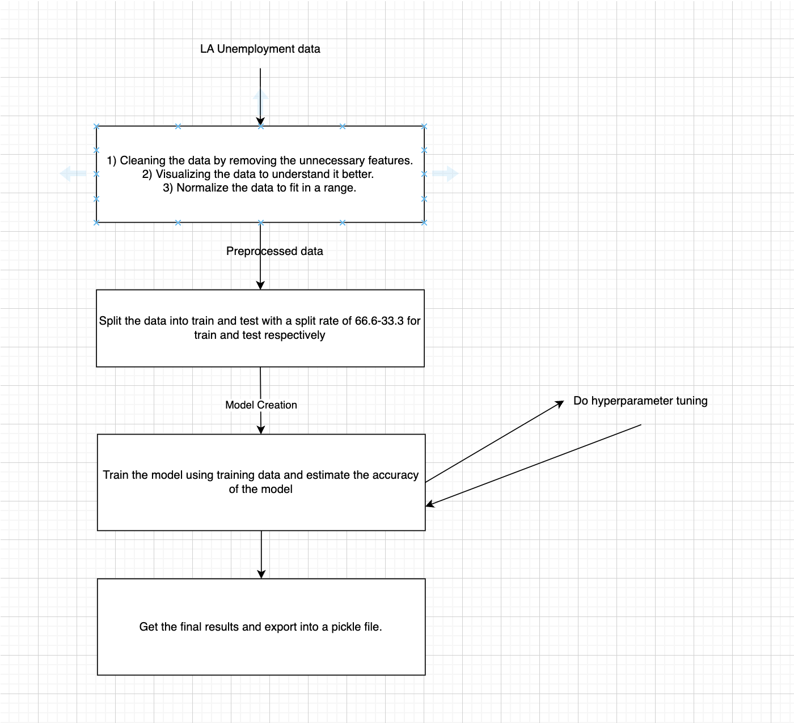
Solution
sb70, maahidp23

Slide 9
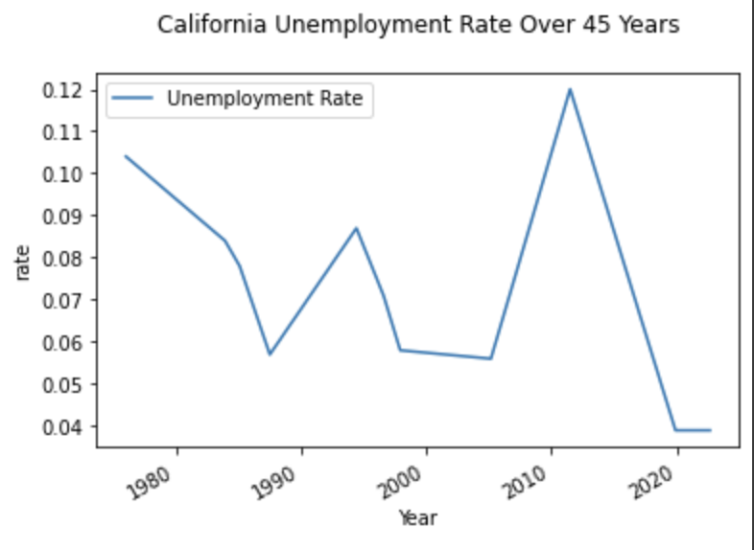
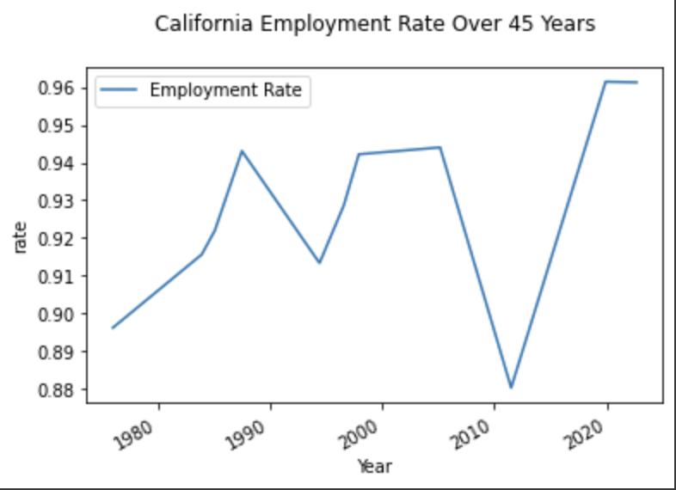
Data visualization
psg4, maahidp23

Slide 10
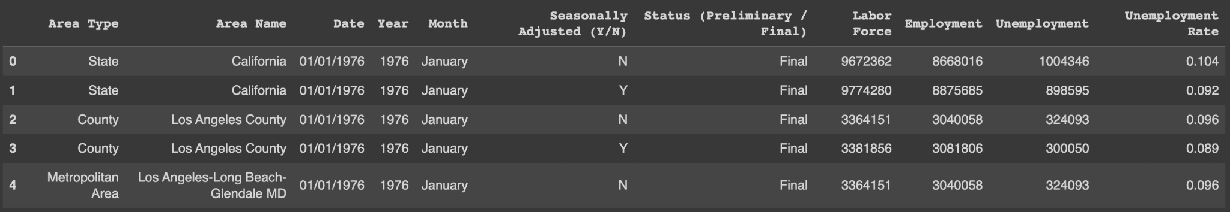
Data head
sk120, sb70

Slide 11
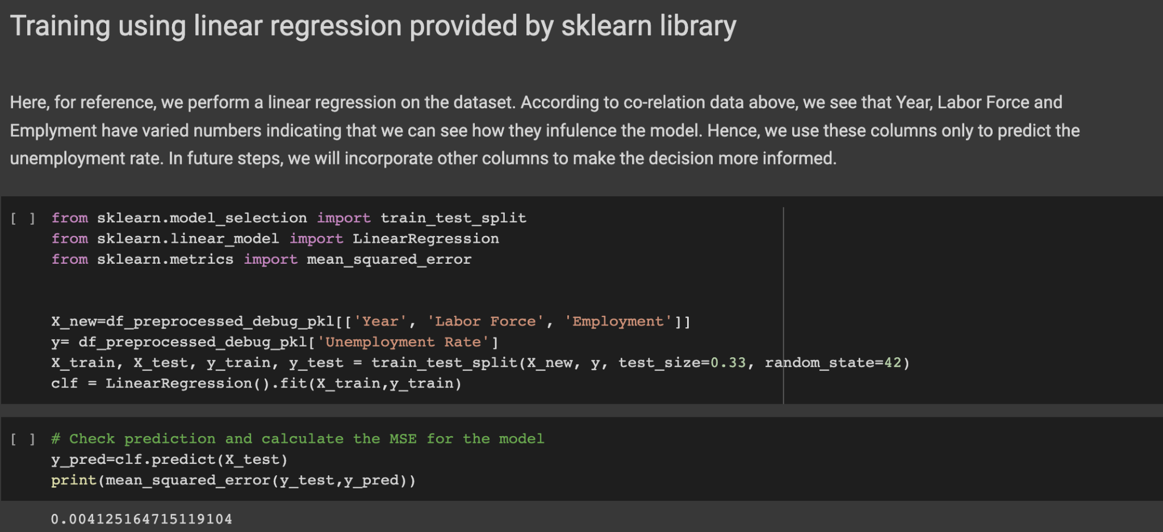
Baseline - Linear Regression
psg4, sk120

Slide 12
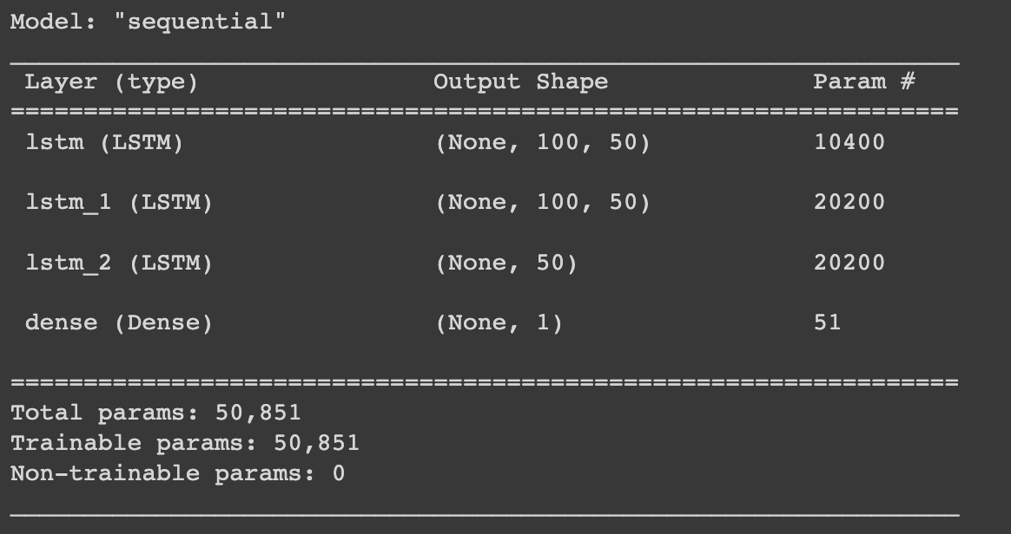
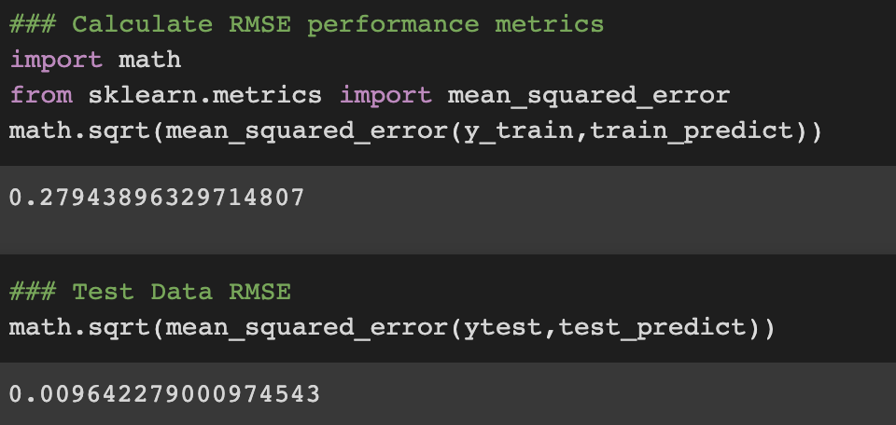
Final LSTM model and the output
psg3,maahidp23

Slide 13
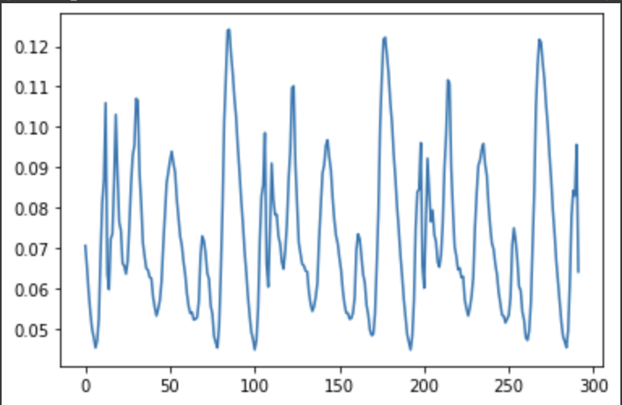
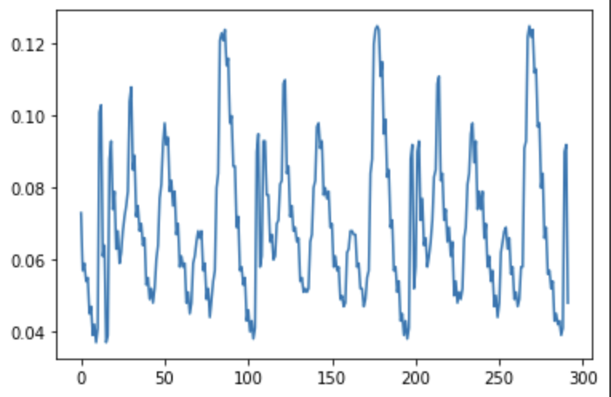
Predicted graph Actual graph
Sb70, sk120, maahidp23

Slide 14
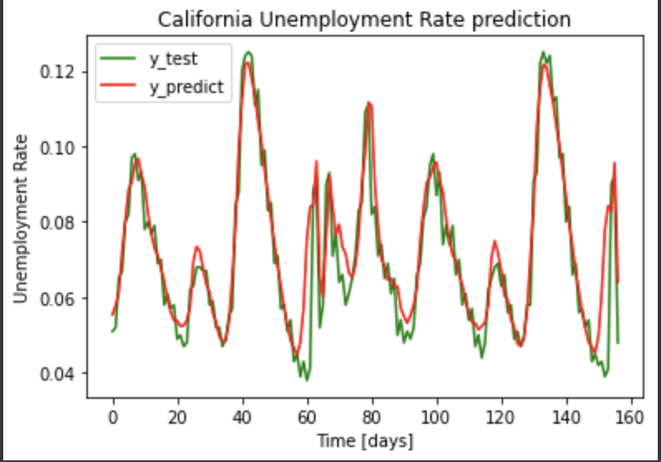
Final prediction graph
sb70, sk120, maahidp23

Slide 15
Results and Conclusion
psg4,maahidp3
We tried with different mini batch sizes and different optimizers. We have found that the batch size of 16 and Adam optimizer is giving us the optimal results.
As for future scope, we can try to find more meaningful features which can affect the unemployment rate, improving the accuracy of the model. We can also use models like ARIMA and SARIMA which can give us much better performance.

Slide 16
Thank you Professor Dr. Sowers and all TAs for your support!
psg4, sk120, sb70, maahidp23

